Slide 1




Estimating Seasonal Behavior States from Bio-logging Sensor Data
Josh M. London
Devin S. Johnson, Paul B. Conn, Brett T. McClintock, Michael F. Cameron, and Peter L. Boveng
jmlondon
@jomilo75
josh.london@noaa.gov
NMFS Research Permit: 15126
ALASKA FISHERIES SCIENCE CENTER
Notes:
BOEM and NOAA Fisheries for supporting the data collection and analysis

Slide 2
The Importance of Seasons
The seasonal timing of key, annual life history events is an important component of many species' ecology.
ALASKA FISHERIES SCIENCE CENTER

Slide 3
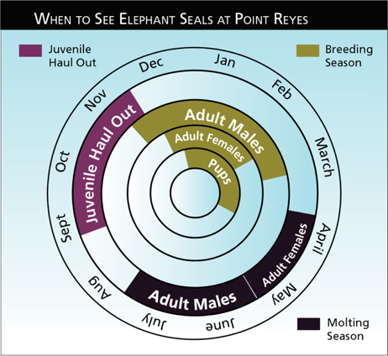
The Importance of Seasons
The timing of key life history events is well documented only for species found in accessible rookeries, breeding areas, or migratory corridors.
Point Reyes National Seashore, National Park Service
ALASKA FISHERIES SCIENCE CENTER
Notes:
Elephant seal calendar
Accessibility = better understanding

Slide 4
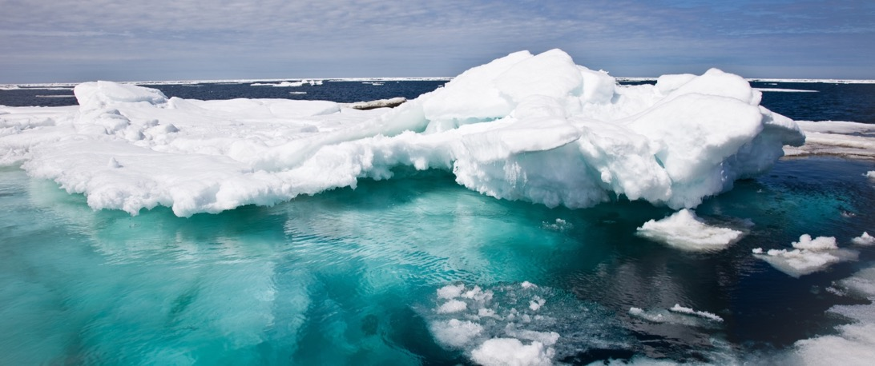
Our knowledge of seasonal timing for species widely dispersed in inaccessible or remote habitats is poor.
ALASKA FISHERIES SCIENCE CENTER
Notes:
This is especially true in the polar regions

Slide 5
Expected Change in Arctic Species
Key life-history events in Arctic species are often closely tied to sea-ice, weather, ocean productivity, and a range of other factors predicted to change dramatically
ALASKA FISHERIES SCIENCE CENTER
Notes:
For ice seals, pupping, breeding and molting are all linked to the presence of sea ice
For other Arctic species the productivity of spring blooms near the ice edge are critical

Slide 6

Seasonal Misalignment
Seasonal periods important to marine mammals often do not align well with typical labels.
ALASKA FISHERIES SCIENCE CENTER
Notes:
When we lack information on seasons, we tend to assign more human-centric definitions

Slide 7
Data From Bio-loggers
Fine-scale observations
Deployment lengths of several months
Record both movement and behavior
Data can be noisy
Large datasets
Position Error
Irregular in Time
Missing Data
ALASKA FISHERIES SCIENCE CENTER

Slide 8
Hidden Markov Models
Pattern recognition in noisy time series
Previously used to identify behavioral states
(e.g. foraging, transit, resting)
Widely used; existing tools
Behavioral states are, typically, shorter time steps
Duration in a state is not dependent on time already spent in a state
ALASKA FISHERIES SCIENCE CENTER

Slide 9
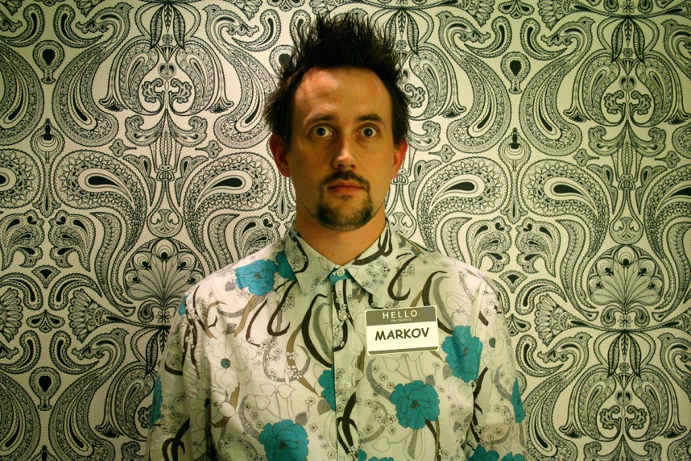
Multivariate Hidden Semi-Markov
Photo Adapted From Ben Husmann
ALASKA FISHERIES SCIENCE CENTER

Slide 10
Multivariate Hidden Semi-Markov
Hidden Semi-Markov models allow an arbitrary sojourn distribution
R package mhsmm
Jared O'Connell, Soren Hojsgaard (2011). Hidden Semi Markov Models for Multiple Observation Sequences: The mhsmm Package for R. Journal of Statistical Software, 39(4), 1-22. URL http://www.jstatsoft.org/v39/i04/.
ALASKA FISHERIES SCIENCE CENTER

Slide 11
Animal Movement Model
Predict locations at regular time steps that align with behavioral observations
R package crawl
Devin S. Johnson (2015). crawl: Fit Continuous-Time Correlated Random Walk Models to Animal Movement Data. R package version 2.0 (development branch available on Github).
ALASKA FISHERIES SCIENCE CENTER

Slide 12
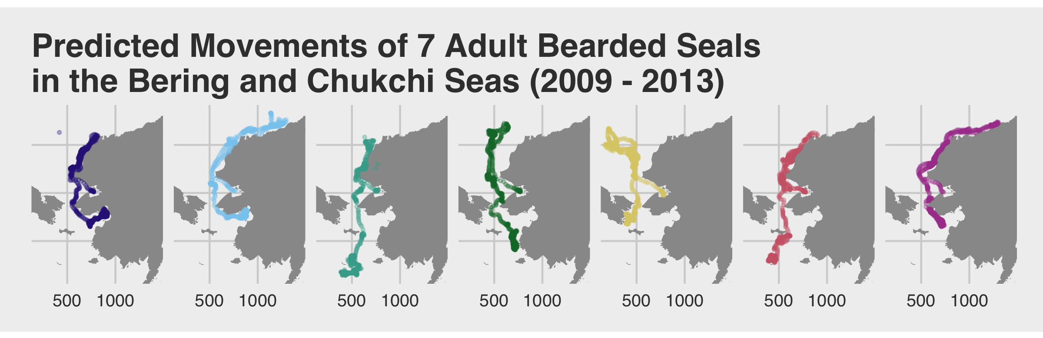
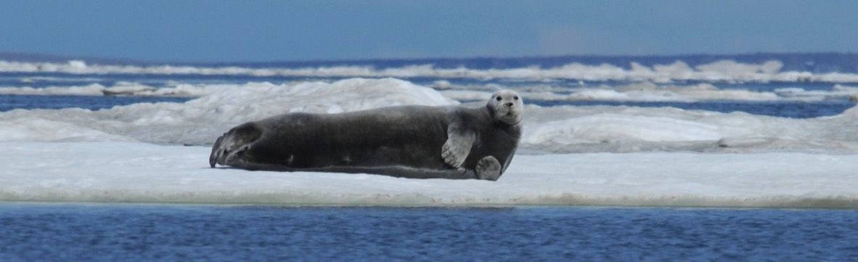
ALASKA FISHERIES SCIENCE CENTER

Slide 13
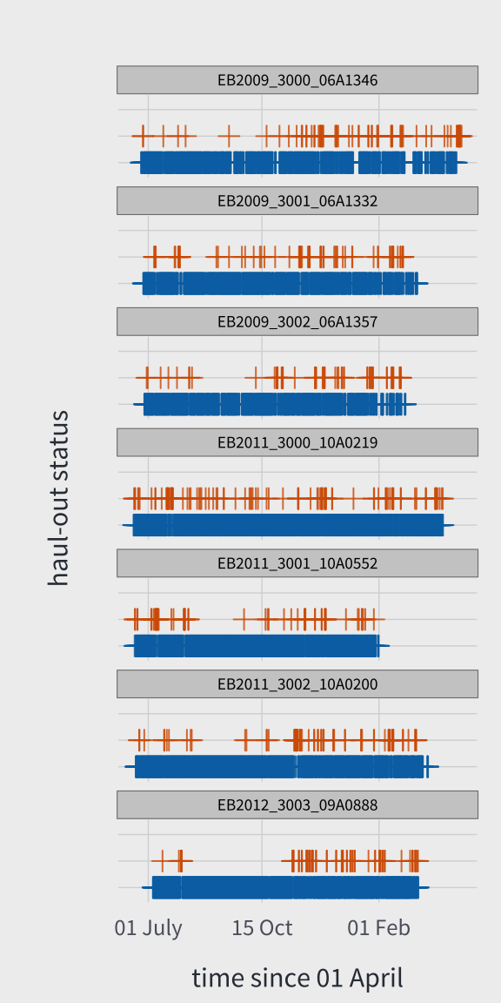
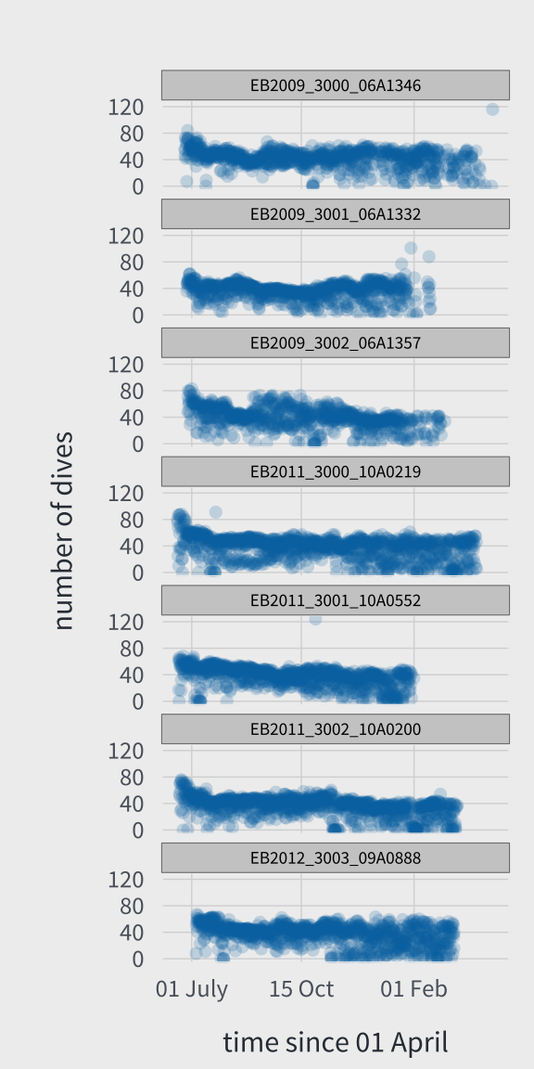
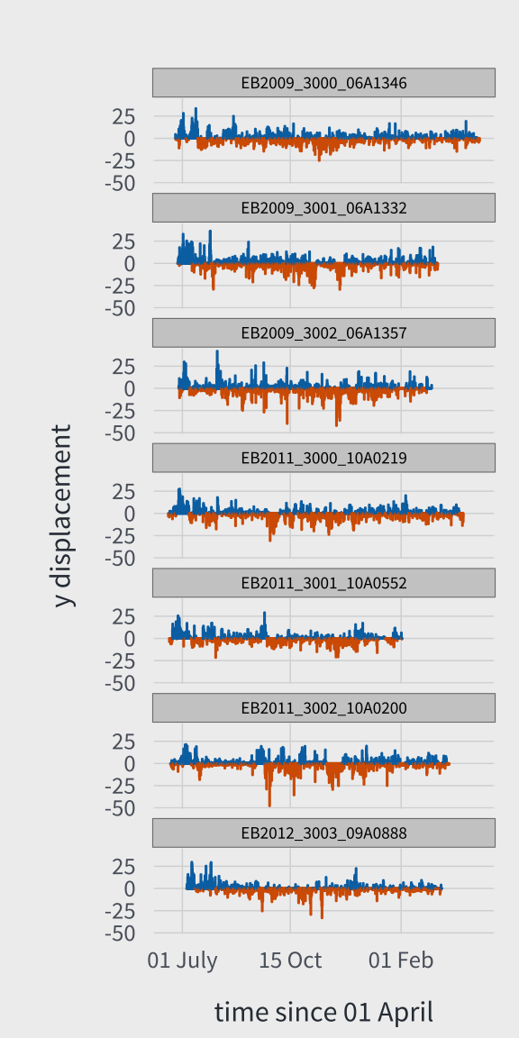
Notes:
Data from biologging sensors deployed on 7 adult bearded seals
Funding and collaboration with BOEM, coastal communities and Alaska natives

Slide 14
mhsmm Parameters
Haul-out status (6 hours)
Bernoulli (initial value: 0.1 for each state)
Number of Dives (6 hours)
Poisson (initial value: 30 for each state)
XY-Displacement (6 hours)
Multivariate Normal (initial value: 0,0; 20,20)
Sojourn Time
Poisson (initial value: mean = n/#States; shift by 0)
ALASKA FISHERIES SCIENCE CENTER
Notes:
Examined 2-7 states;
AIC and other evaluations led us to settle on 4

Slide 15
Number of States
Unknown, but we have some prior knowledge
seals captured towards end of molt
summer/fall = open water, less ice
winter/spring = ice advances south
More states, less seasonal time scale
4-6 states seems reasonable
Model Selection or Pick a Value
ALASKA FISHERIES SCIENCE CENTER
Notes:
Examined 2-7 states;
AIC and other evaluations led us to settle on 4

Slide 16
5 Seasonal States
Molt Transition Period
Open Water
Migration South w/ Ice Advance
Winter Site Fidelity
Early Stages of Pupping/Breeding
ALASKA FISHERIES SCIENCE CENTER
Notes:
Examined 2-7 states;
AIC and other evaluations led us to settle on 4

Slide 17
Transition Matrix
0 1 0 0 0
0 0 1 0 0
0 0 0 1 0
0 0 0 0 1
0 0 0 0 0
Mimic the Seasonal Progression
Start at State 1
Super-diagonal Entries set to 1
Transition Matrix is Locked (not re-estimated)
ALASKA FISHERIES SCIENCE CENTER
Notes:
Examined 2-7 states;
AIC and other evaluations led us to settle on 4

Slide 18
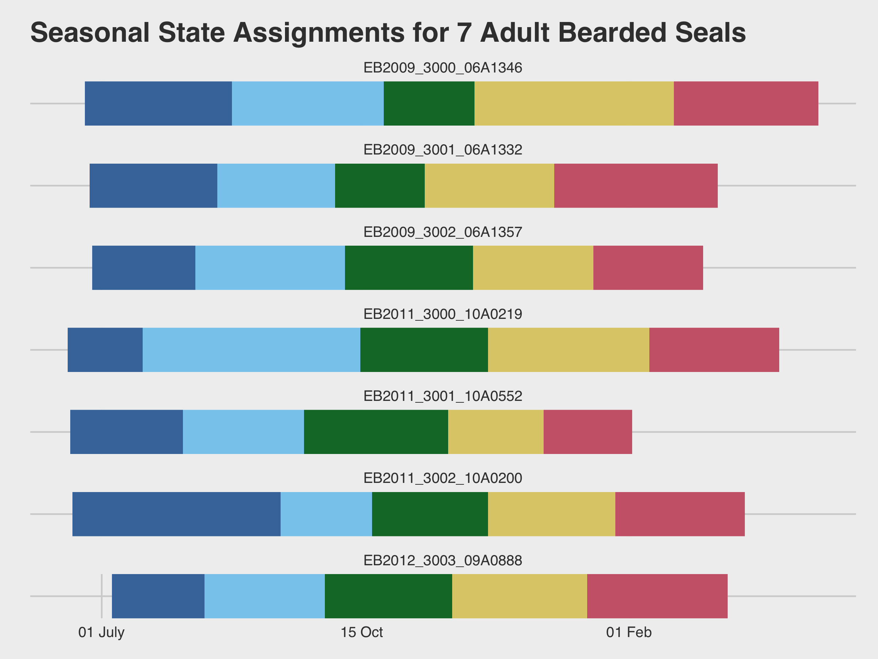

Slide 19
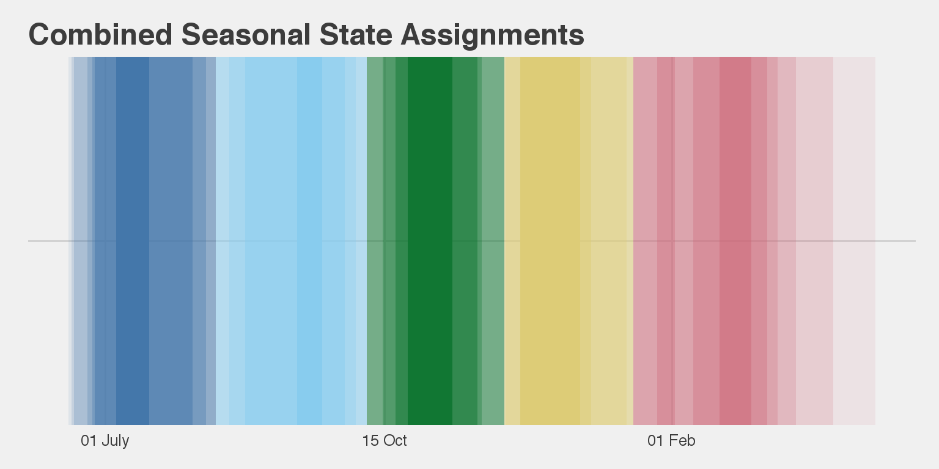
Notes:
Here we use transparency to represent the percentage of tags that were in the majority state

Slide 20
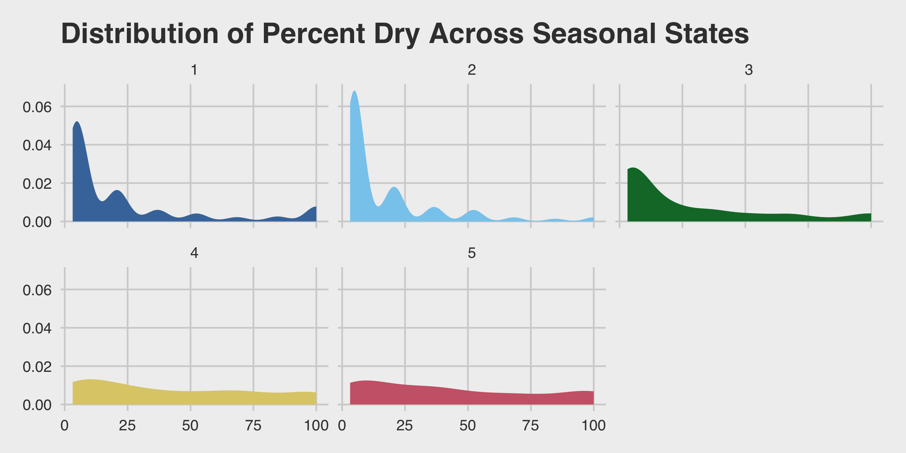
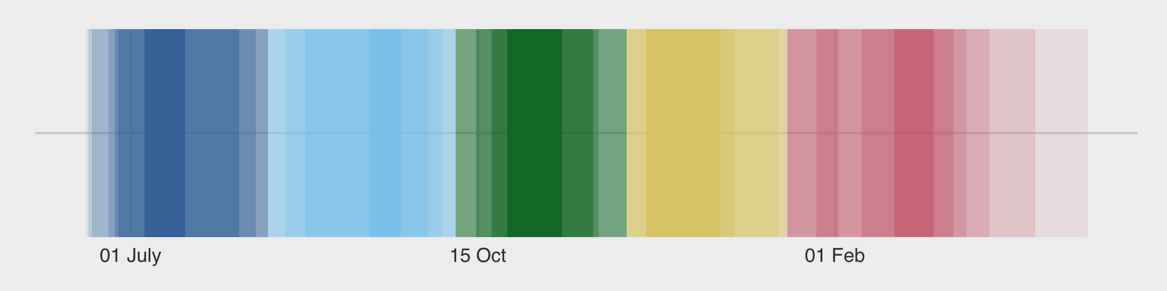

Slide 21
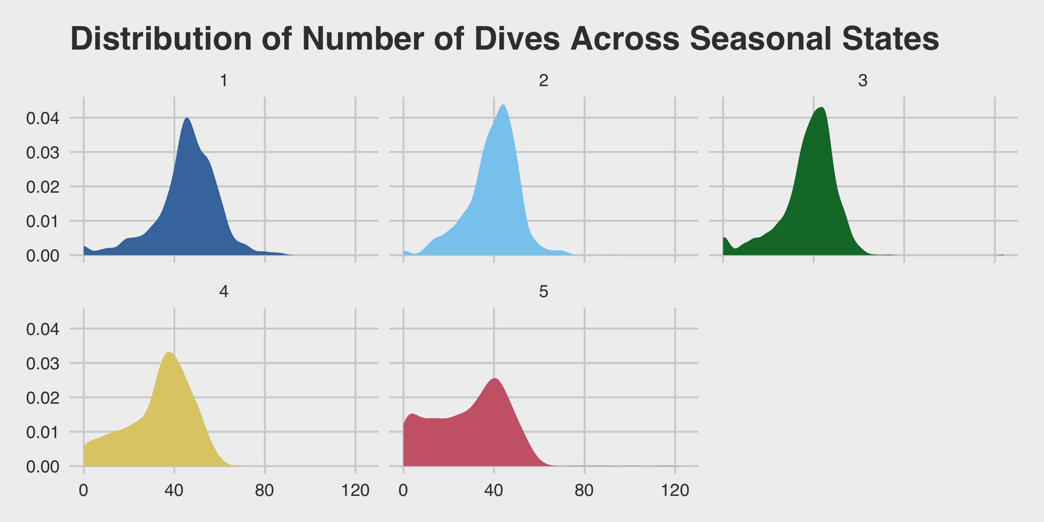

Slide 22
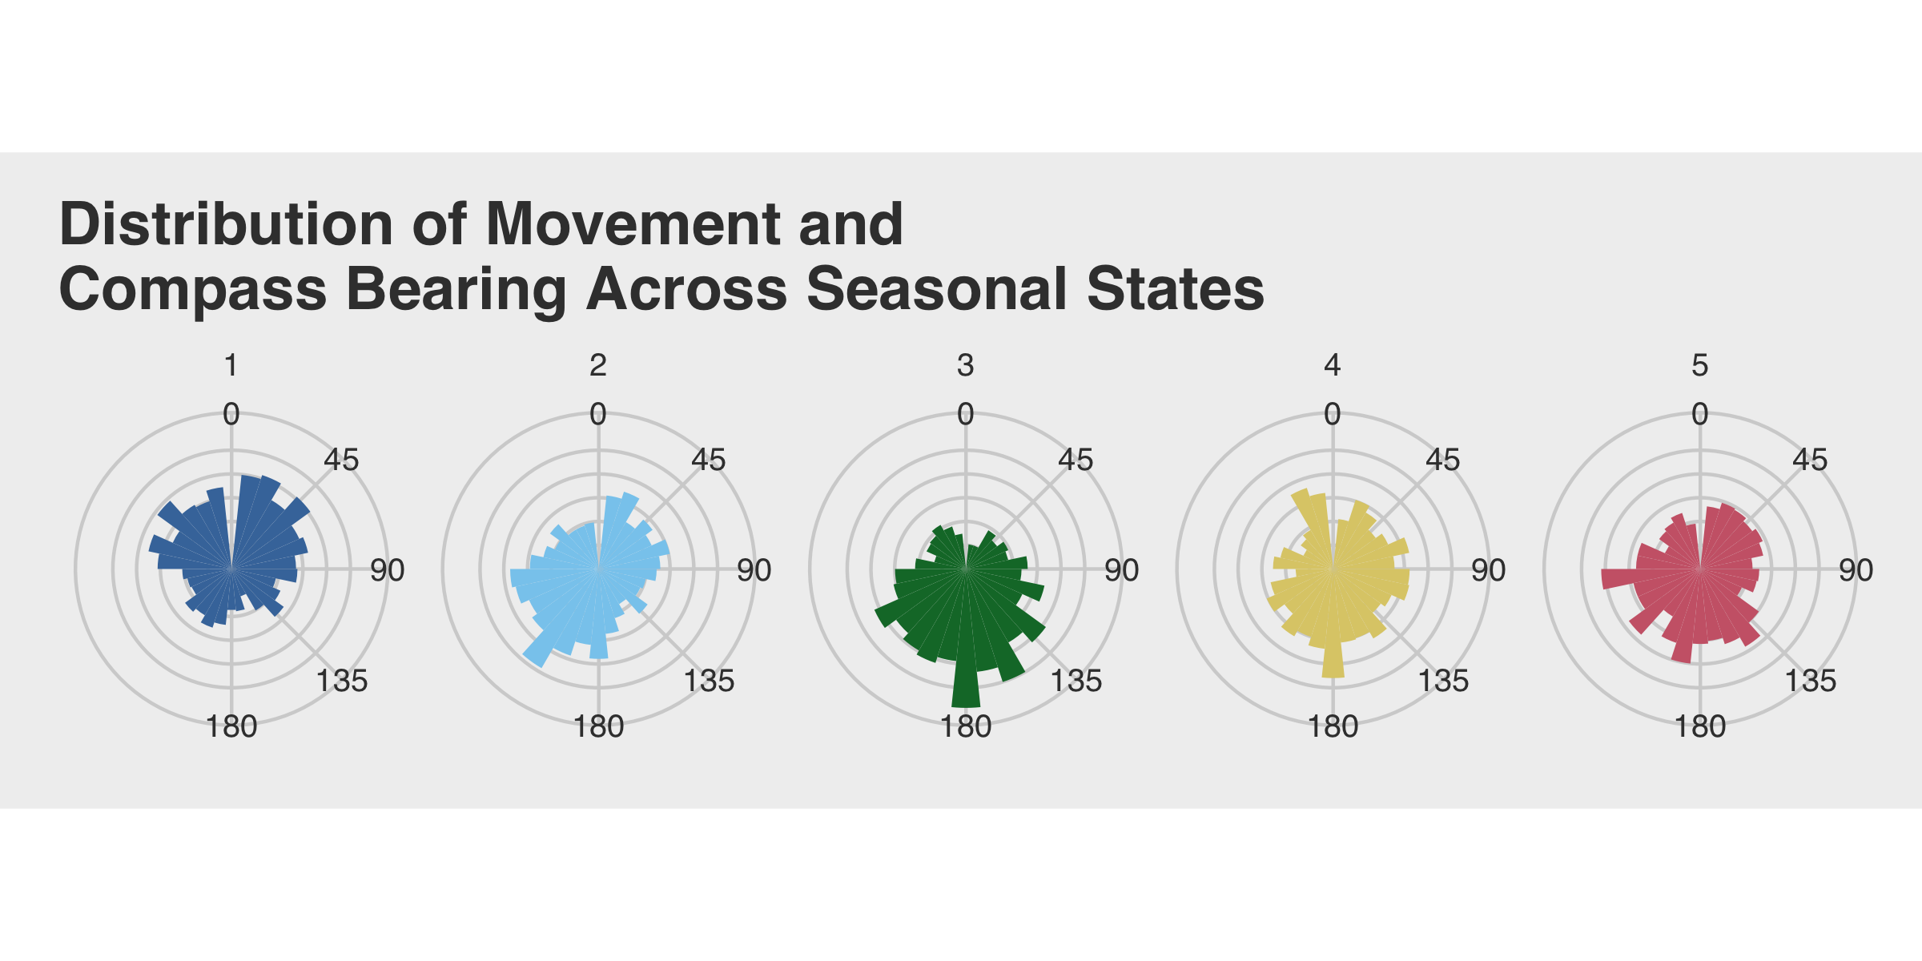

Slide 23
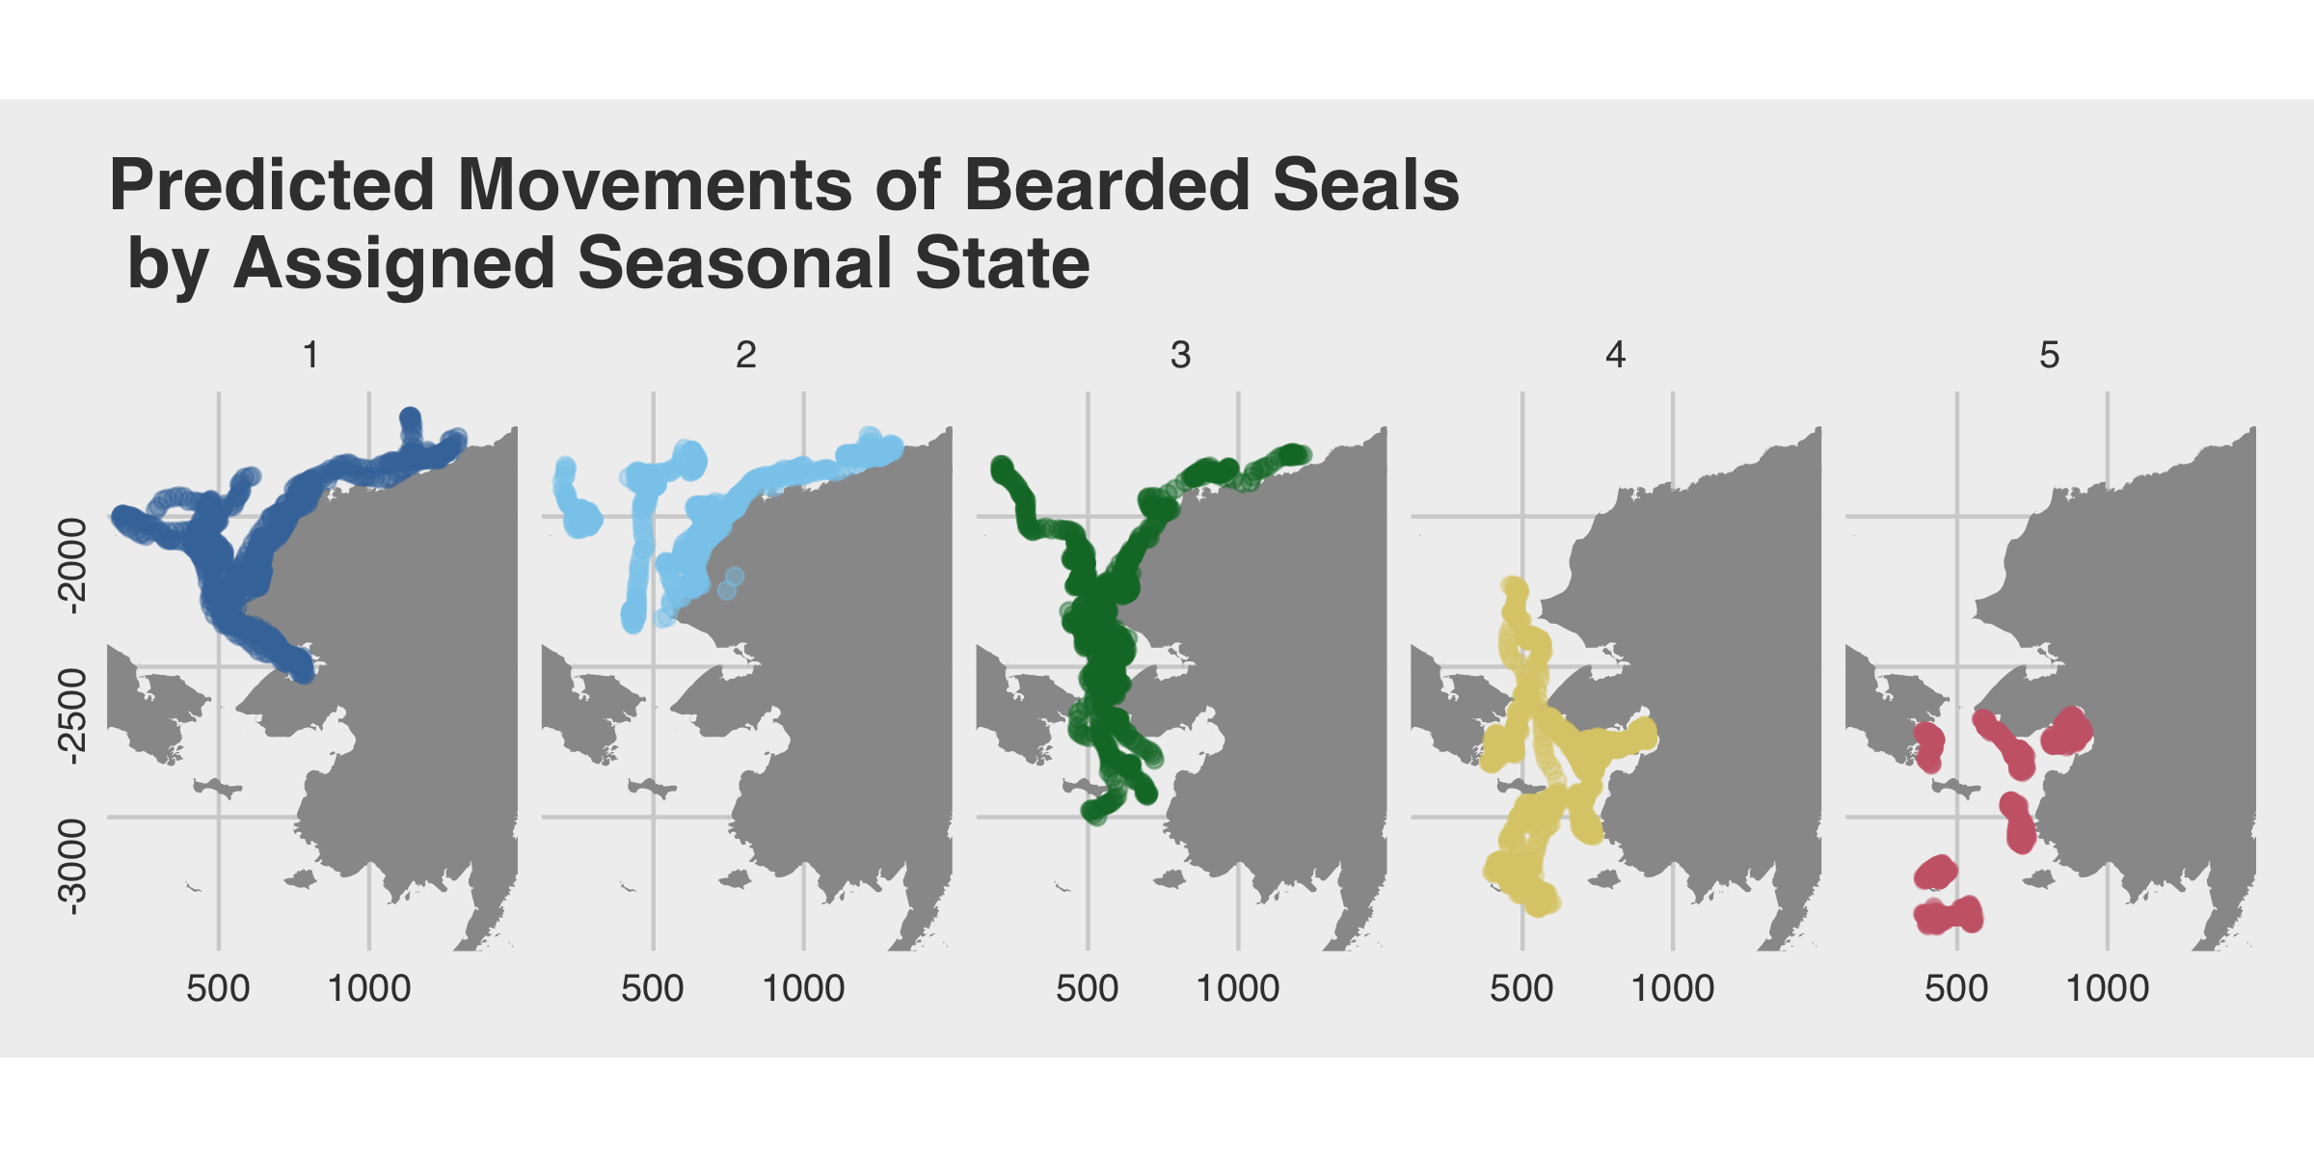

Slide 24
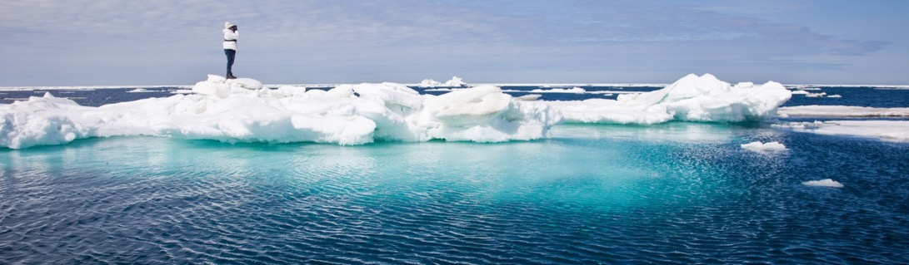
Bearded seal results tell a nice story and aligns with our understanding of their ecology
Expanding to other species and larger, more complex datasets may not be as nice
ALASKA FISHERIES SCIENCE CENTER

Slide 25
Future Considerations
Still just a ‘proof of concept’
Model selection for optimal number of states
Metrics for evaluating model performance
Explore other time steps for observations
Explore additional sensor data
ALASKA FISHERIES SCIENCE CENTER

Slide 26
Conclusions
Bio-logging provides our best insight into the seasonal timing of key life-history events
Could prove a useful tool for measuring change in remote, less accessible species
ALASKA FISHERIES SCIENCE CENTER

Slide 27
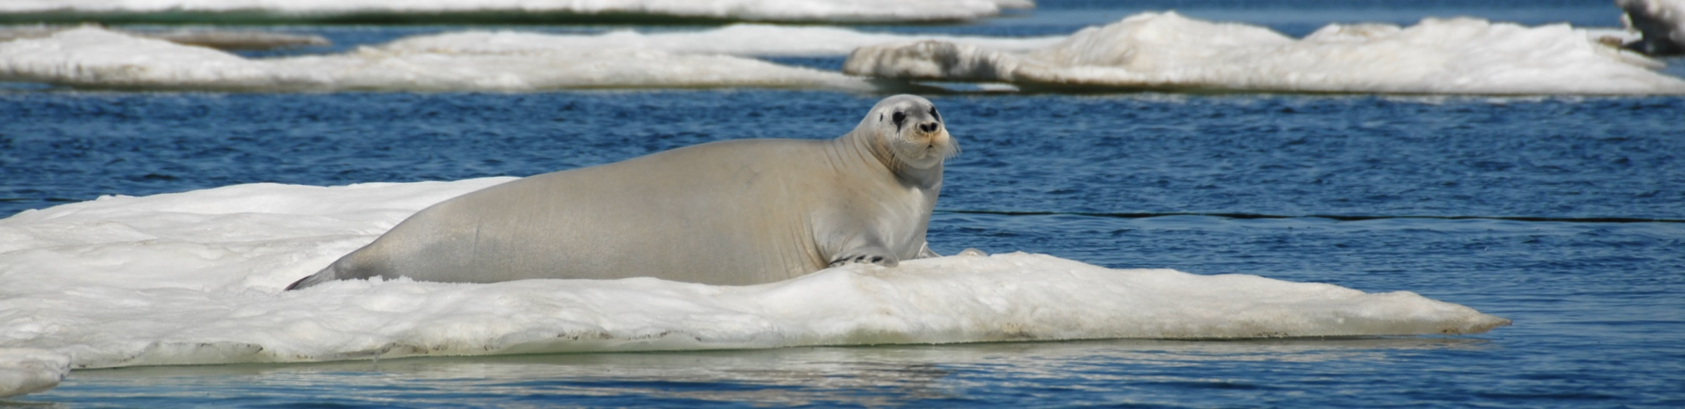
Questions
DISCLAIMER
The scientific results and conclusions, as well as any views or opinions expressed herein, are those of the author(s) and do not necessarily reflect those of NOAA or the Department of Commerce
ALASKA FISHERIES SCIENCE CENTER

